Slide 1
FYP5: Object Detection, Tracking and Suspicious Activity Recognition for Maritime Surveillance using Thermal Vision

Slide 2
Weekly Tasks
Begin the control system, platform model and IMU data for a full simulation
Simulation of the Platform by considering the mathematical model of the Stewart platform and Solidworks

Slide 3
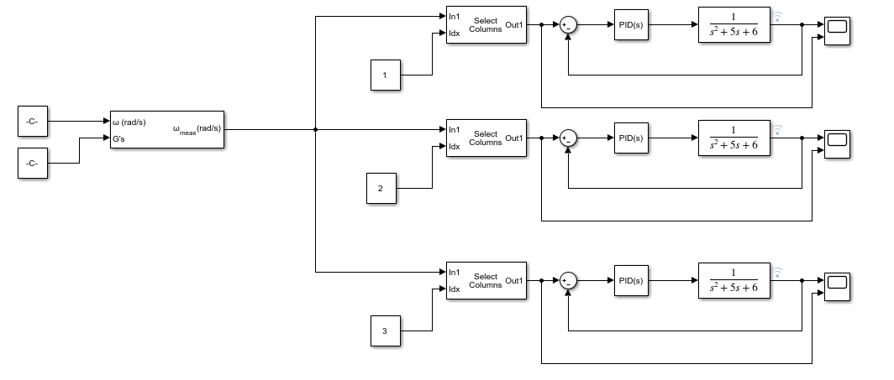
Control System using MATLAB

Slide 4
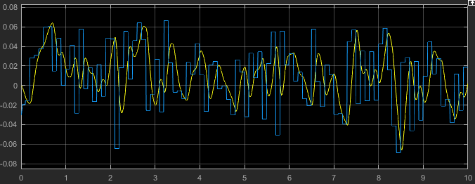
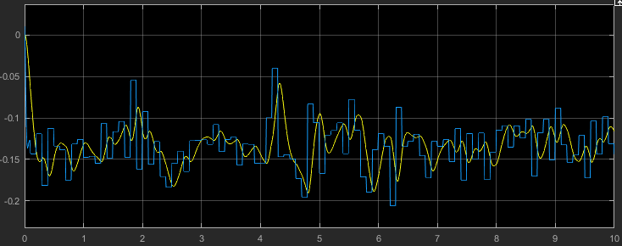
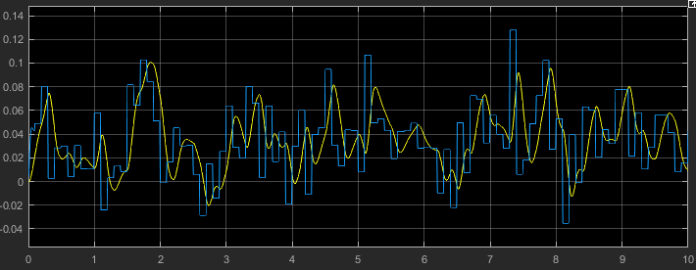



Results
$$ω_{x}$$
$$ω_{y}$$
$$ω_{z}$$

Slide 5
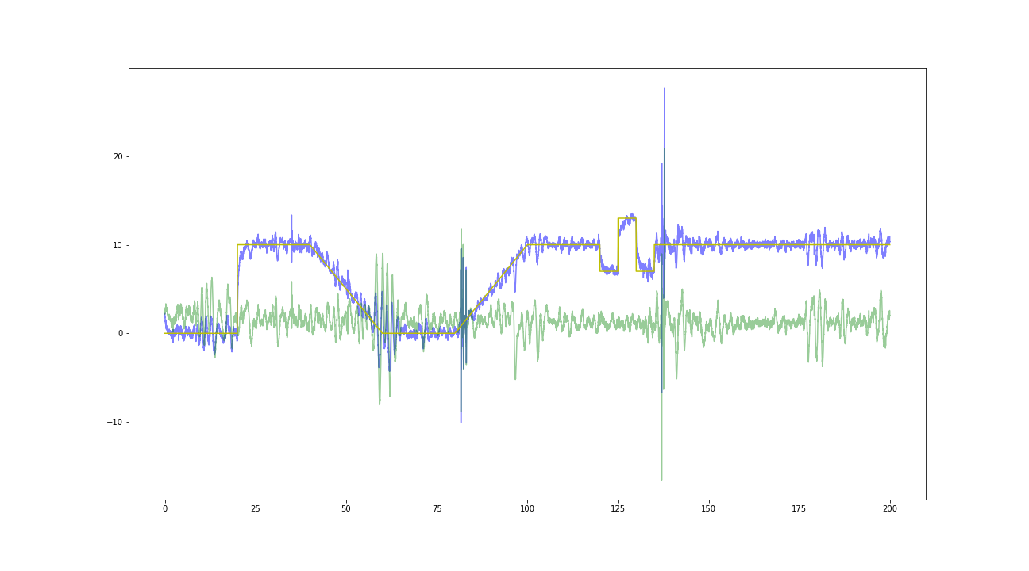
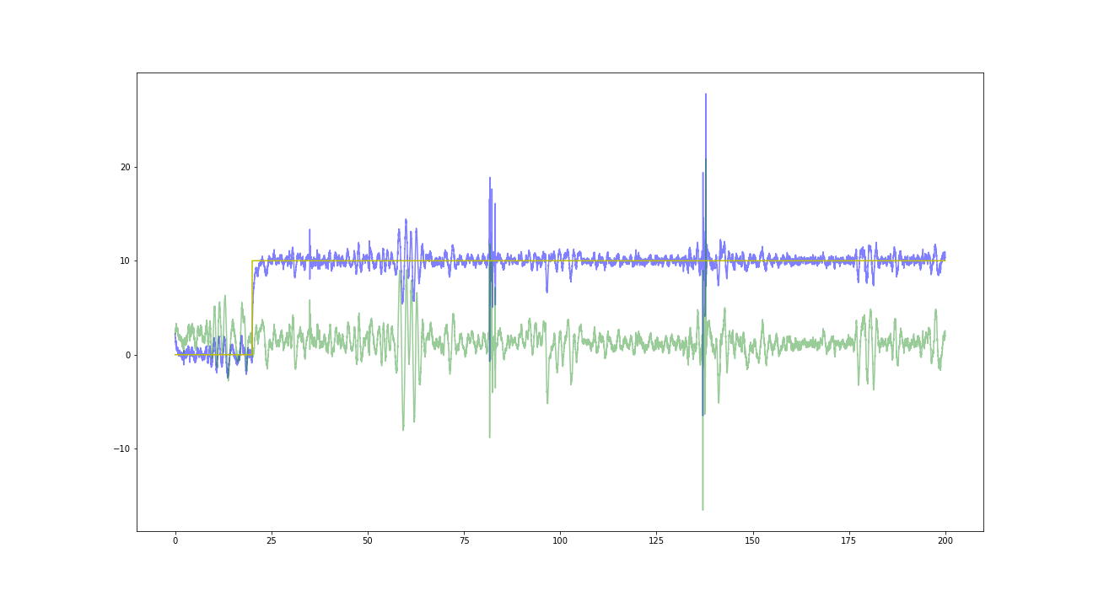
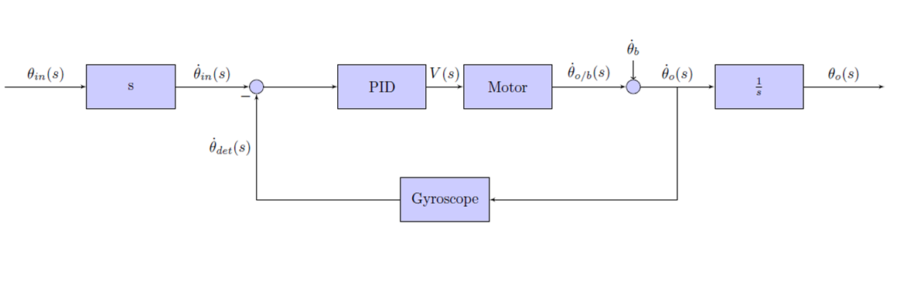
Control System with disturbances

Slide 6
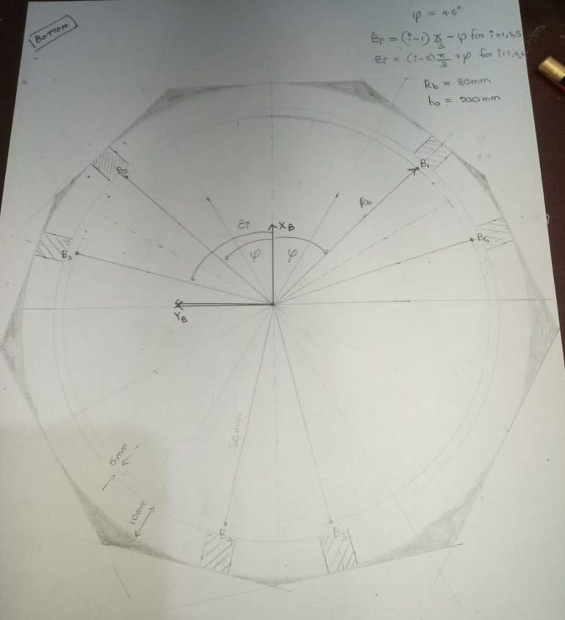
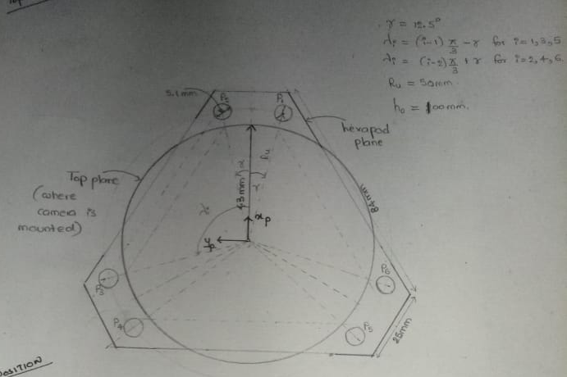
Stewart Platform Design
Mechanical Design
SolidWork Design – 3-D model (Work In Progress) based on the hand sketch (some parameters were changed from initial hand sketch due to the interferences at the joints)
Preliminary Design – Hand sketches of Base Platform and Top Platform

Slide 7
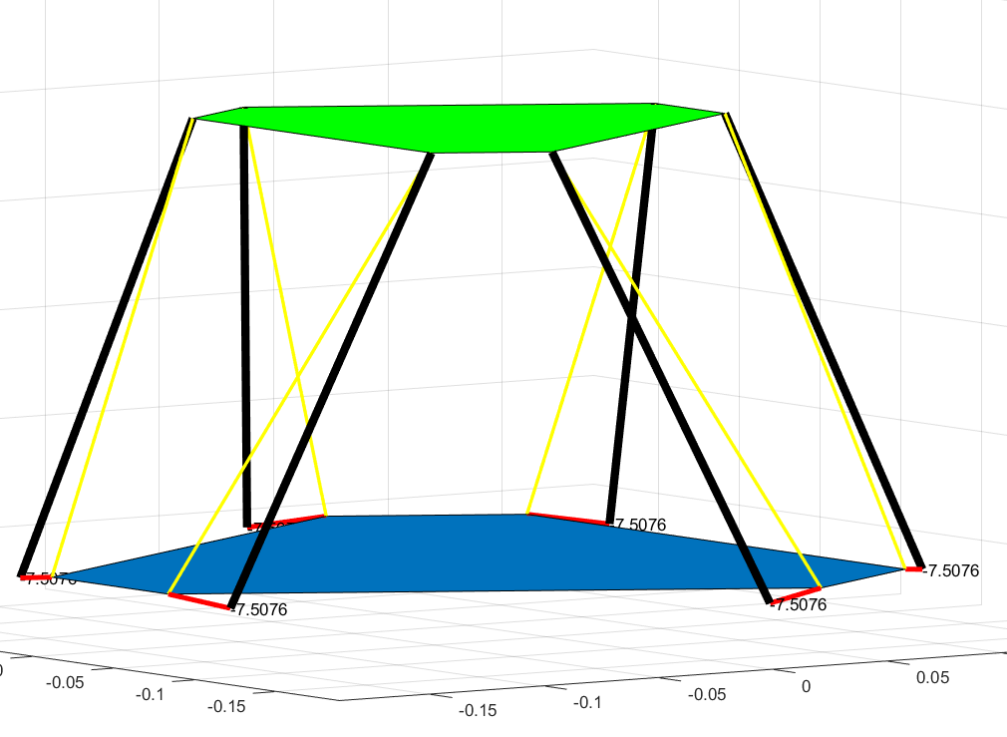
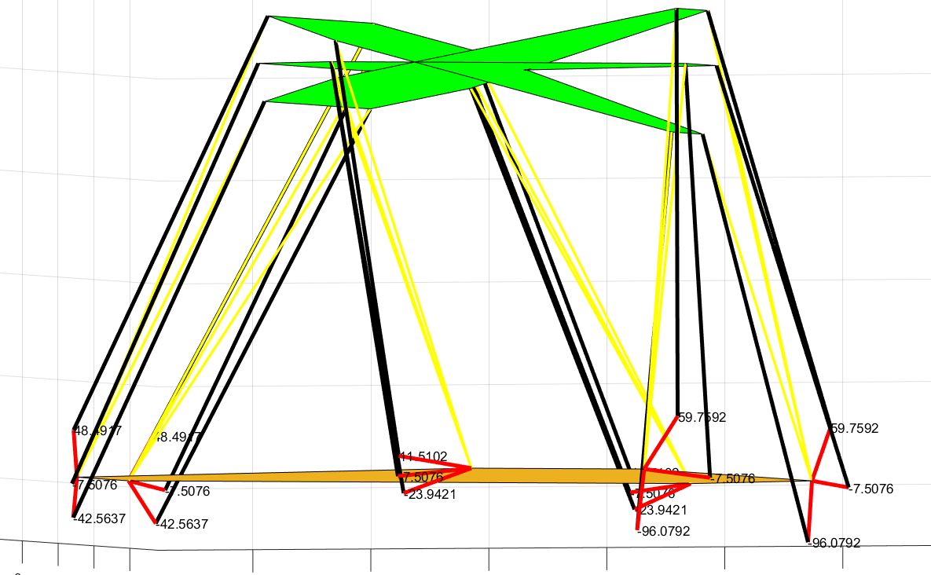
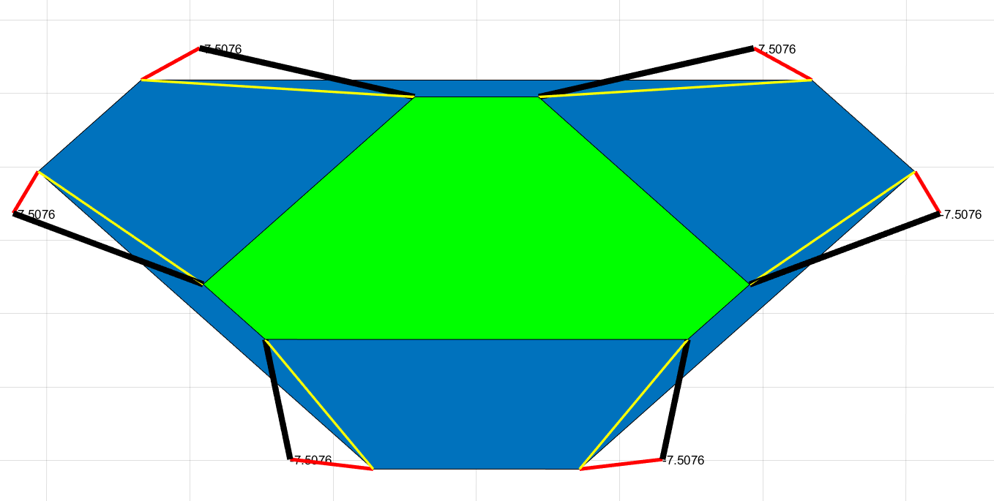
Inverse Kinematic Calculation and Visualization
Based on the published Literatures calculated derived the equations relevant to calculate the virtual leg lengths and servo angles
Implemented the equations on MatLab to derive angles of each servo arm for the possible pure Yaw, Pitch, Roll ranges - These values are then used on SolidWork on more detailed analysis
Visualized the 3-D platform based on the given orientations
Pitch (the range –16 to 20degrees)
Platform at the Home Position - (a.) Side View (b.) Top View

Slide 8
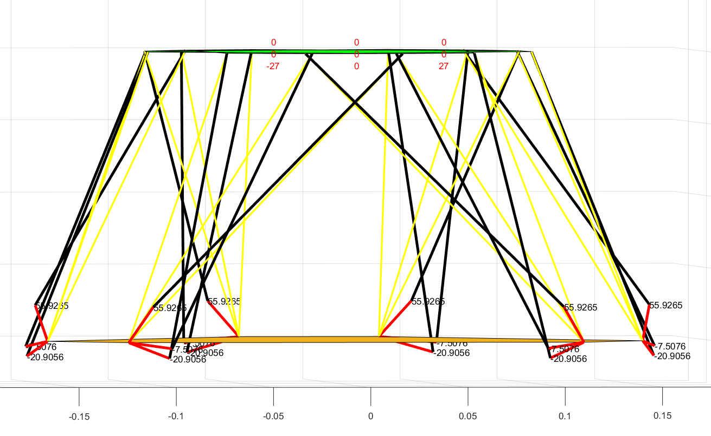
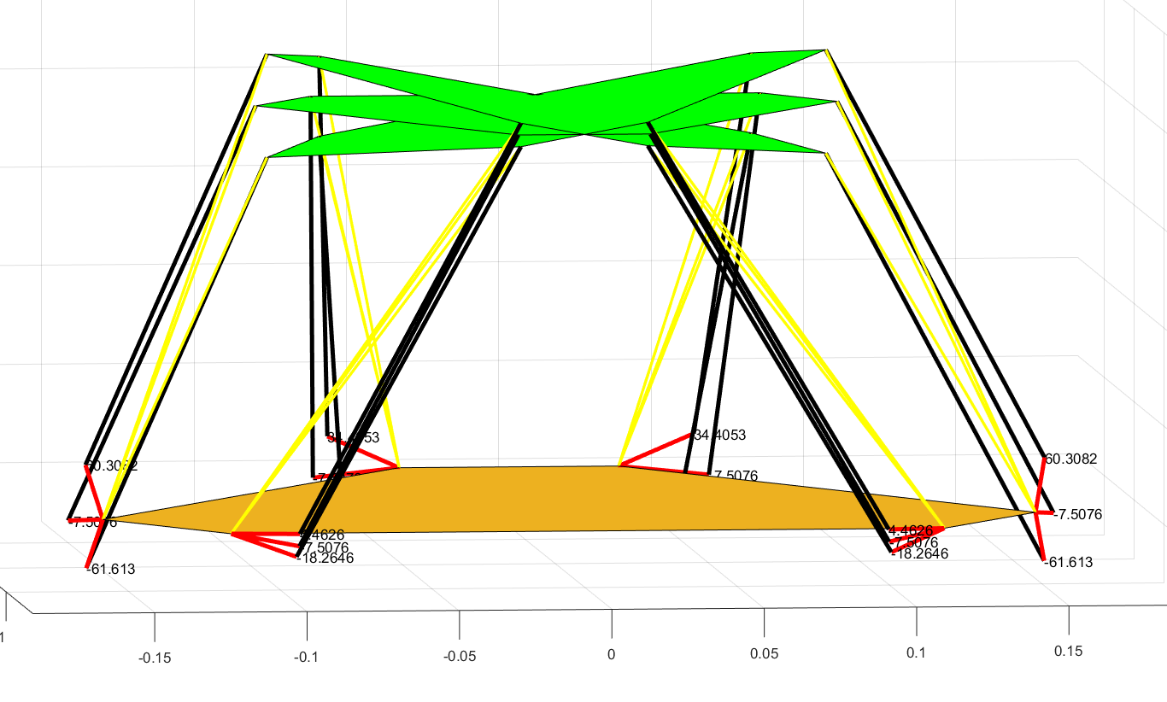
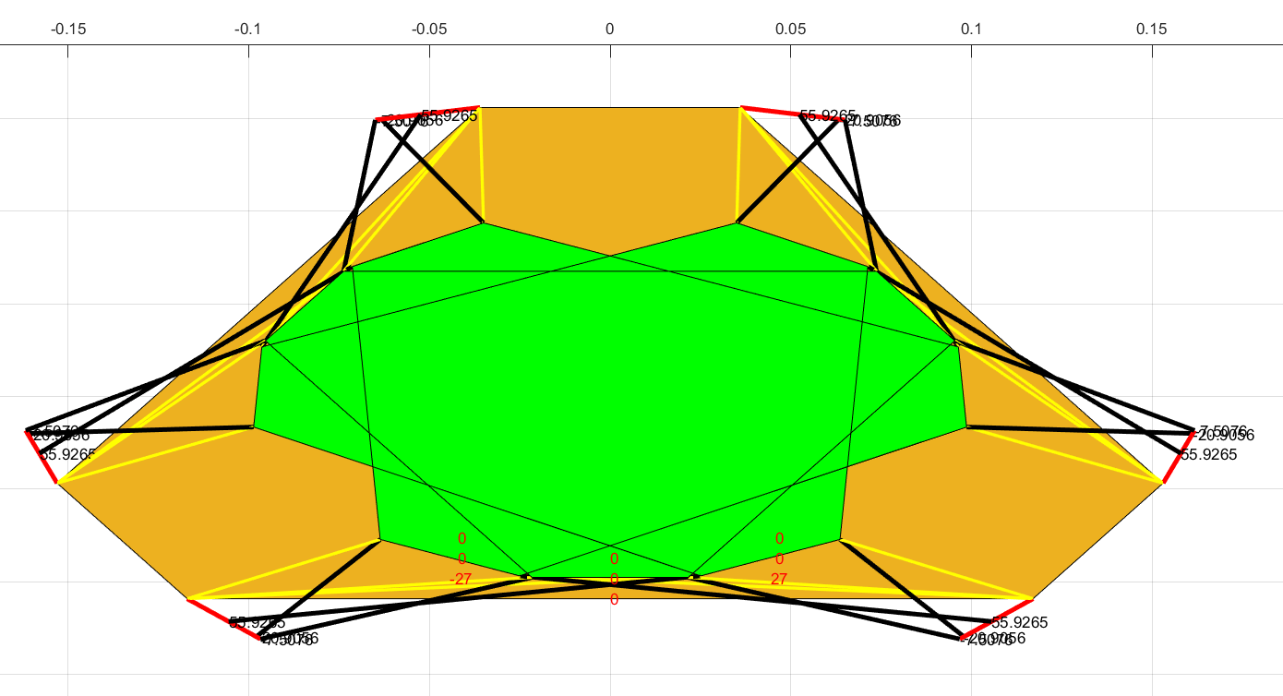
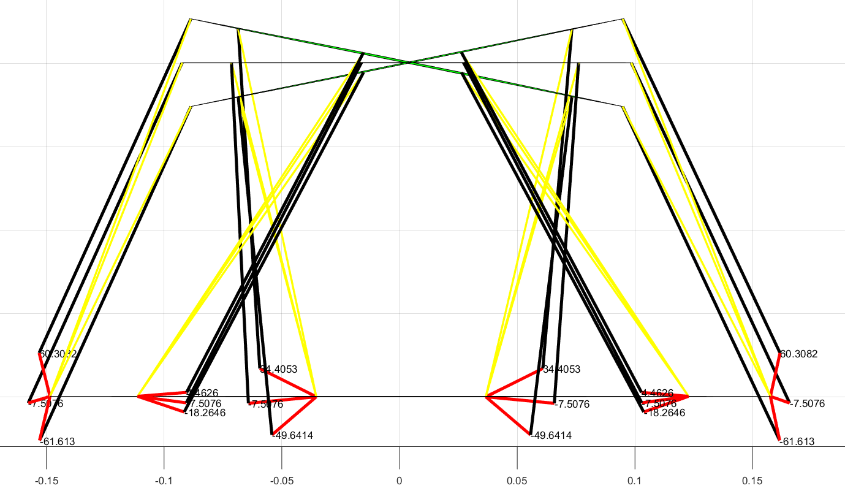
Yaw (the range –27 to 27 degrees)
Roll (the range –16 to 16 degrees)

Slide 9
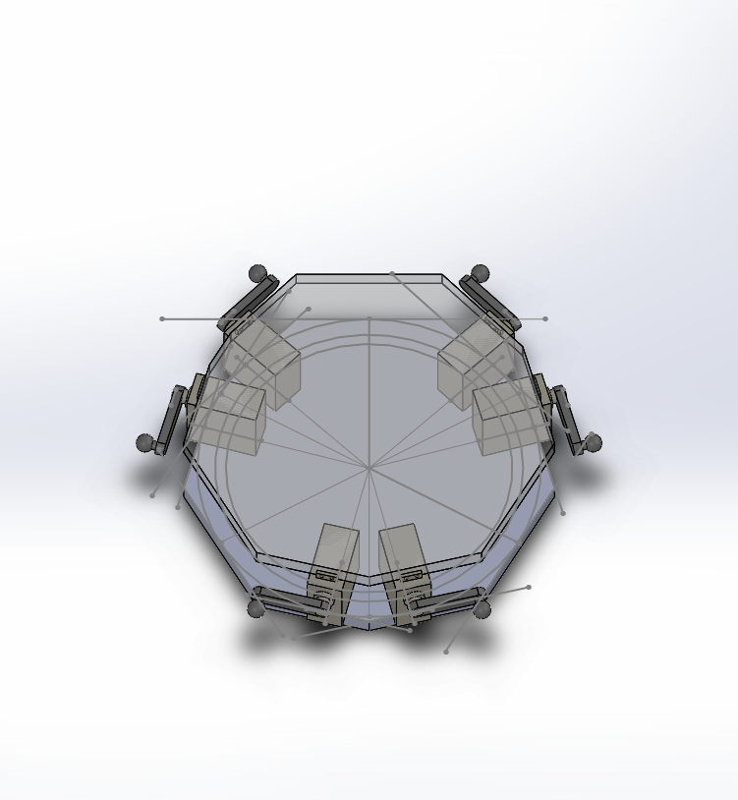
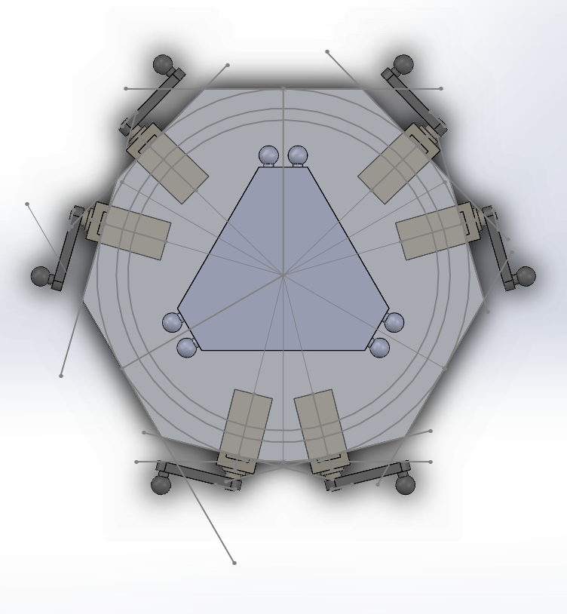

Slide 10
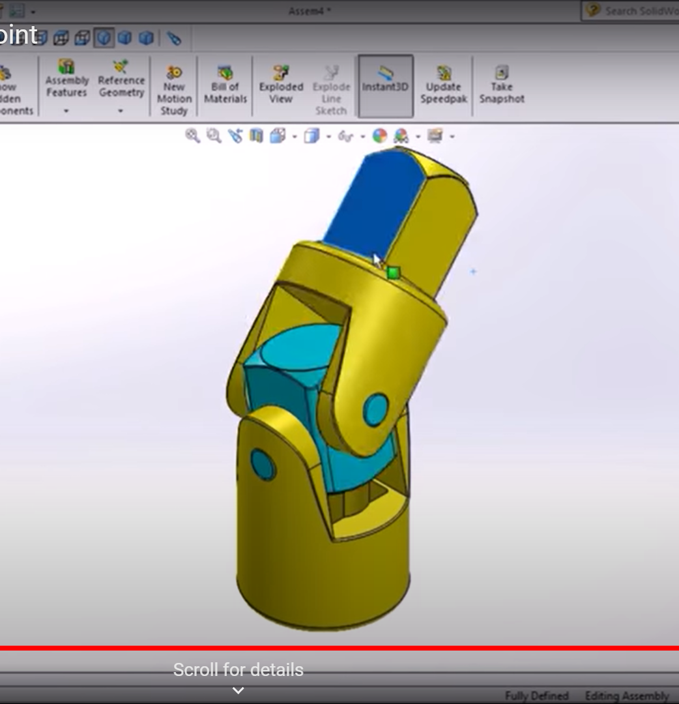
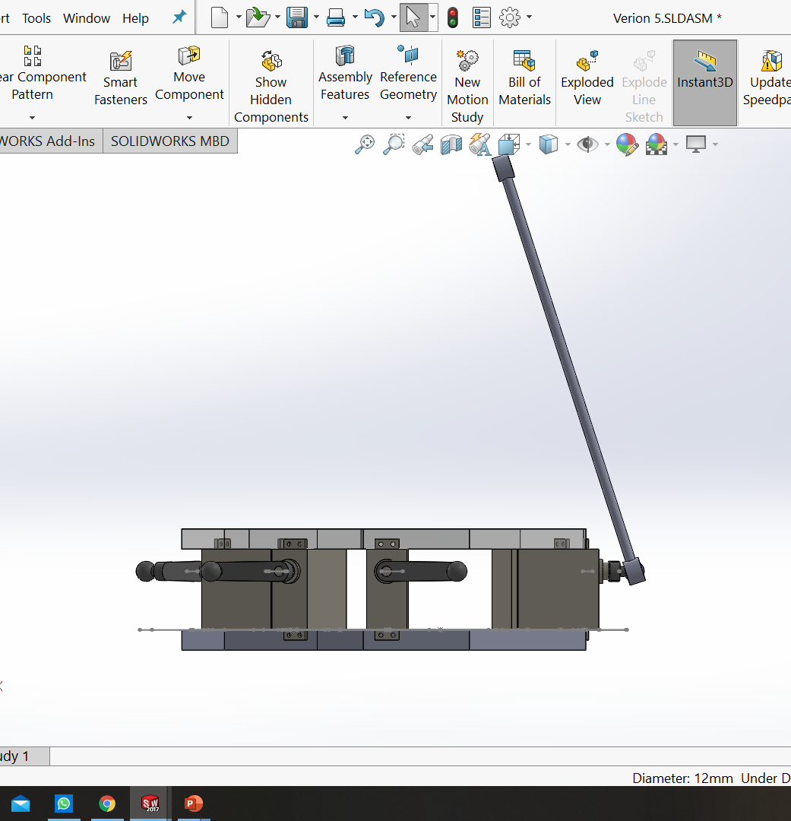

Slide 11
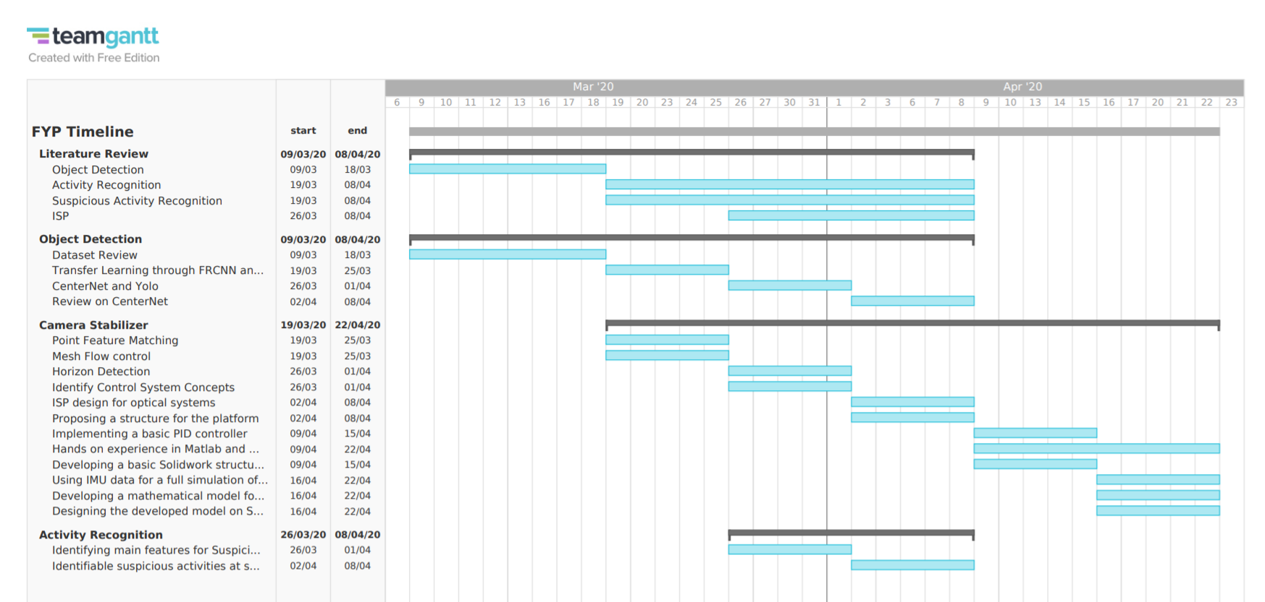

Slide 12

Tasks for next week
Continue working on the mechanical platform design using Solidworks and performing necessary calculations.
Developing and simulating multiple platform designs.
Getting ahead with activity recognition.
Improving the developed control system.

